Slide 1


IT Tickets
Performance

Slide 2
Agenda
Problem Statement
Data Description
Objective Key Metrics and Visualizations
Subjective Question for Insights

Slide 3
Problem Statement
The objective is to analyse the IT support ticket management system to understand the performance of IT agents, the efficiency of ticket resolution, and the satisfaction levels of employees. The analysis aims to identify high and low performers among IT agents, assess the overall effectiveness of the team, and pinpoint areas for improvement in the ticket resolution process. The ultimate goal is to make informed staffing decisions, including hiring, firing, and training, to enhance overall service quality and team performance.

Slide 4
Data Overview
Tickets Sheet: Contains information about IT support tickets.
ID: Unique identifier for the ticket.
Ticket Fecha: Date of the ticket.
Employee ID: ID of the employee who raised the ticket.
Agent ID: ID of the agent assigned to the ticket.
Request Category: Category of the request (e.g., Login Access, System, Software).
Issue Type: Type of issue (e.g., IT Error, IT Request).
Severity: Severity of the issue.
Priority: Priority level of the issue.
Resolution Time (Days): Time taken to resolve the ticket.
Satisfaction Rate: Satisfaction rate provided by the employee (1-5 scale).
IT Agents: Contains information about IT agents.
Agent ID: Unique identifier for the agent.
Full Name: Full name of the agent.
Email: Email address of the agent.
Year of Birth: Year the agent was born.
Month of Birth: Month the agent was born.
Day of Birth: Day the agent was born.

Slide 5
Methodology
Data Cleaning: Various functions & tools like Trim(), Proper(), Find & Replace, Left(), Right() & filter() have been used in cleaning the dataset
Data Enrichment: Enhanced the functionality of dataset by using functions like vlookup() and Index() to search for various key performance variables.
Data Aggregation: Functions like AVERAGEIF(), MAX(), MIN(), SUMIF(), COUNTIF() have been used to derive specific metrics out of the data set.
Trend Analysis: Deployed various pivot tables and their respective time series charts to determine trendline of the performance.
Platform Segmentation: Categorized the platform used to identify the user activity in each of them
Visualization: Using dynamic charts and slicers data visualizations have been shown to derive meaningful inferences.

Slide 6
If there is an investment, should it be used to hire more IT agents, improve training programs, or upgrade ticket management software?
System requests (39,002) are the highest, making them the most common IT support issue.
Login Access (29,193) is the second-largest category, indicating frequent account-related problems.
Software requests (19,570) occur moderately compared to other request types.
Hardware requests (9,733) are the lowest, suggesting fewer hardware-related issues.

Slide 7
Age Group wise Satisfaction.
The 54–58 age group has the highest customer satisfaction (4.39).
The 34–38 age group records the lowest satisfaction (3.96).
The 29–33 age group also shows a high satisfaction score (4.21).
Overall, customer satisfaction remains above 4.0 across most age groups.

Slide 8
Tickets by Satisfaction Score
Most tickets received the highest satisfaction score of 5 (50,770), indicating a very positive customer experience.
Score 4 is the second most common (27,562), showing that most users were satisfied with the support.
Very few tickets received a score of 2 (1,977), indicating a low number of dissatisfied customers.
Overall, the satisfaction ratings are heavily concentrated on scores 4 and 5, reflecting strong IT support performance.
Total
97,498

Slide 9
Tickets by Resolution Time
Most tickets are resolved on the same day (0 days), with 25,071 tickets, indicating a high rate of quick issue resolution.
Ticket volume decreases as resolution time increases, showing that only a small number of issues require longer resolution periods.
Most tickets are resolved within 10 days, reflecting an efficient IT support process.
Very few tickets take more than 15 days to resolve, indicating that long-pending cases are rare.

Slide 10
Tickets by Severity
Normal severity tickets dominate with 88,656 tickets, indicating that most issues are routine and non-critical.
Major severity tickets (4,836) are significantly fewer than normal tickets, showing that high-impact issues are relatively uncommon.
Minor severity tickets account for 2,258, while Urgent tickets are only 1,392, indicating that critical incidents occur infrequently.
Unclassified tickets are minimal (356), suggesting that most tickets are properly categorized.

Slide 11
Category & Quarter wise Resolution time
Hardware tickets have the highest resolution time (7.5–7.7 days) across all quarters, making them the most time-consuming category.
Login Access tickets are resolved the fastest (around 0.31 days), showing a highly efficient resolution process.
Software and System tickets maintain consistent resolution times of around 5.2 days and 6.6 days, respectively, across all quarters.
Resolution time remains stable across all four quarters for every request category, indicating consistent IT support performance throughout the year.

Slide 12
Satisfaction rate Months & Year wise

Slide 13
Insight
Customer satisfaction shows a steady upward trend, improving from 3.96 in early 2016 to around 4.16 by the end of 2020.
The highest satisfaction score (4.27) was recorded in July 2020, indicating peak customer satisfaction.
Customer satisfaction consistently remained above 4.0 from 2017 onwards, reflecting sustained improvement in service quality.
Although there are minor monthly fluctuations, the overall trend remains stable and positive, showing consistent IT support performance over the years.

Slide 14
Tickets by Months & Year wise

Slide 15
Insight
Ticket volume shows a steady year-over-year increase, rising from around 1,100 tickets in 2016 to over 2,600 tickets by the end of 2020.
The highest ticket count (2,609) was recorded in December 2020, indicating the peak workload during the analysis period.
Despite minor monthly fluctuations, the overall trend is consistently upward, reflecting growing demand for IT support.
The sharp increase in ticket volume during 2020 suggests increased system usage while the support team continued to manage the higher workload effectively.

Slide 16
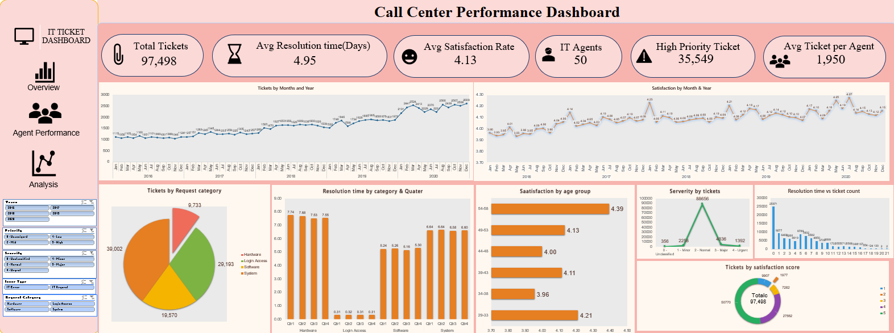
Dashboard

Slide 17
Recommendation.
Focus on reducing system-related tickets, as they account for the largest share of requests. Investigate the root causes and implement preventive maintenance to minimize recurring issues.
Provide targeted training to IT agents handling hardware and system-related requests, as these categories have the highest average resolution time. At the same time, recognize and reward high-performing agents to encourage consistent performance.
Improve the support experience for the 34–38 age group, which has the lowest customer satisfaction, by collecting feedback and identifying the reasons behind their lower ratings.
As ticket volume has increased significantly over the years, hire additional IT support staff or optimize workload distribution to maintain quick resolution times and high customer satisfaction as demand continues to grow.

Slide 18
Conclusion.
The analysis shows that the IT support team has maintained strong overall performance despite a continuous increase in ticket volume. Most tickets are resolved quickly, customer satisfaction has steadily improved over the years, and the majority of employees rate the service highly. While system-related requests and hardware issues require additional attention due to their higher volume and longer resolution time, the overall ticket management process is effective. With targeted training, better resource allocation, and strategic hiring based on workload, the organization can further improve service quality, increase customer satisfaction, and enhance overall team performance.

Slide 19
Thank You!!
…Vivek Dubey

